Slide 1
DEMAND, ADJUDICATION AND RECOVERY PROCEEDINGS

Slide 2
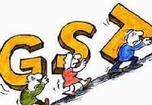
Topics for Discussion
Determination of tax not/short paid or erroneously refunded [S.66]
Tax collected but not deposited with the Government [S.69]
Tax wrongfully collected and deposited with Government [S.70]
Recovery of tax [S.72]
Payment of tax and other amounts in installments [S.74]
Transfer of property to be void in certain cases [S.75]
Tax to be first charge on property [S.76]
Provisional attachment [S.77]
Continuation of certain recovery proceedings [S.78]

Slide 3
Issue of Show Cause Notice - Normal Period
Tax not paid / short paid or erroneously refunded or ITC wrongly availed / utilised, when there is no intention to evade – notice to be issued at least three months prior to the time limit specified for issuance of order i.e three years.
Subsequent period- Statement of Demand to be issued.
Tax paid with interest before service of notice either by own or informed by department- no notice or penalty.
Where amount paid falls short of the amount actually payable – notice will be issued to covering the extent of such short fall.

Slide 4
Issue of SCN - Normal Period …
Tax paid with interest within 30 days from the date of issue of SCN- No penalty and all proceedings initiated in SCN will be dropped.
If not paid, proper officer, determine the tax, interest and a penalty equivalent to 10% of tax or Rs.10000/- whichever is higher, and issue an order.
An adjudication order shall be issued within 3 years from the due date for filing of annual return for the year to which the dispute arises and in case of refunds, order to be passed within 3 years from the date of erroneous refund.

Slide 5
Issue of Show Cause – Extended Period
Tax not paid / short paid or erroneously refunded or ITC wrongly availed / utilised, where fraud/wilful statement/ suppression of facts involved – notice to be issued at least 6 months prior to the time limit specified for issuance of order i.e 5 years;
Subsequent period, SOD’s to be issued .
If tax , interest and 15% of penalty equivalent to such tax paid before service of notice, then no notice will be served on him.
Where amount paid falls short of the amount actually payable, proper officer to issue notice for such amount.

Slide 6
If tax, interest and a penalty equivalent to 25% of tax is paid within 30 days of notice – no further penalty is payable and proceedings will be dropped.
If no payments were made as above, order will be passed within 5 years
Adjudication to be passed within a period 5 years from the due date of filing of annual return for the year to which tax not paid . In case of erroneous refund, within 5 years from the date of refund paid.
If the tax, interest and penalty equivalent to 50% of tax, is paid within 30 days of the communication of the order, all proceedings in respect of such tax, shall be deemed to be concluded.

Slide 7
How to Calculate the Limitation for the Issue of Show Cause Notice and Adjudication Order
Illustration
SCN can be issued between
Sept 2017
To
30th Sep 2021
SCN can be issued between
Sept 2017
To
30th June 2023
Tax due for the month of Sept 2017 not paid
Normal Period The order should be issued within 3 years. | Extended period The order should be issued within 5 years.
Financial Year
1/4/2017 to 31/3/2018
between
31/12/2018
to
31/12/2023
Due date for filing the Annual return for the above financial year is 31/12/2018
between 31/12/2018
To
31/12/2021

Slide 8
Tax Collected but not deposited with the Government
Tax collected should be deposited in the account of Central / State Government, regardless of whether the supplies in respect of which such amount collected are taxable or not;
If not credited to Central / State Government a/c– Notice will be issued for recovery of tax, interest and penalty;
Order to be passed within one year, after giving opportunity hearing to party.
Amount so recovered shall paid adjusted against the demand and the balance to be credited to the Fund or the person who has borne the incidence of such amount.

Slide 9
Tax wrongfully collected & deposited with Government
A transaction considered as intra-state supply and paid CGST/SGST, which is subsequently held to be an inter-state supply, then refund of amount so paid shall be granted subject to such conditions as may be prescribed.
A transaction considered to be an inter-state supply and paid IGST, which is subsequently held to be an intra-state supply, tax payer shall not be required to pay interest on the amount of CGST/SGST payable.

Slide 10
Initiation of Recovery Proceedings Sec.71
In the absence of any appeal, demand so confirmed by way of Order passed is required to be paid within 90 days from the date of service of order. in the absence of any appeal filed.
Any amount payable by a taxable person in pursuance of the order passed in this act, shall be paid within 90 days from the date of service of the such order. Provided, if the officer considers it expedient in the interest of revenue, he may , for reasons records in writing, direct such person to remit the same within the shorter period.

Slide 11
Recovery of Tax (Sec.72)
Modes of Recovery
Department can recover the dues from the amounts if any payable by the department to the tax papyer viz., refund etc.,
Any goods of the tax payer which is under the control of the department can also be detained and sold in order to recover the said dues.
Department can issue notice to any other person from whom money is due or may become due to such person to pay the amount to the Government.
Every person to whom the notice is issued shall be bound to comply with such notice and in particular, where any such notice is issued to a post office, banking company or an insurer, notwithstanding any rule, practice or requirement to the contrary.

Slide 12
Any person who fails to make the payment in pursuance to a notice under this section shall be deemed to be a defaulter for the amount specified in the notice .
Proper officer may on authorization by the competent authority, distrain any moveable or immovable property belonging to or under the control of such person, and detain the same until the amount payable is paid .
Recovery can also be made through District Collector, treating it as an land revenue.
A CGST officer during the course of recovery of CGST arrears may recover the arrears of SGST and vice versa.

Slide 13
BAR on Recovery Proceedings
Where an appeal has filed before Commissioner/Tribunal against the demand, the proper officer may not enforce the payment of demand until the appeal is resolved.
Other than the above, there is no bar to recover under this provisions.

Slide 14
Payment of Tax and other amounts in Instalments
Other than the amount due as per the liability self assessed in any return, the Commissioner, can allow payment of any amount due payable on monthly installments not exceeding 24 months, subject to payment of interest.
Where there is default in payment of any one installment on its due date, the whole outstanding balance payable on such date shall become due and payable forthwith, which shall be recovered without any further notice.

Slide 15
Transfer of Property to be Void in Certain Cases
Once after determination of tax dues payable by tax payer, the tax payer makes any transfer, sale mortgage, exchange etc with an intention to evade the tax dues, then such charge or transfer shall be treated as void.
Such charge or transfer shall not be void if it is made for adequate consideration and without notice of pendency of such proceeding, or without notice of such tax or other sum payable by the said person or with the previous permission of the proper officer

Slide 16
Tax to be First Charge on Property
Any amount payable by a taxable person or any other person on account of tax , interest or penalty, which he is liable to pay to the Central or a State Government shall be a first charge on the property of such taxable person or such other person .
During the pendency of any proceedings under sec. 60, sec. 61, sec. 62 sec. 66, 67 or 79, if the Commissioner is of the opinion that for the purpose of protecting the interest of the government revenue, he may by order in writing attach provisionally any property belonging to the taxable person in the manner prescribed
Every such provisional attachment shall cease to have effect after the expiry of a period of one year from the date of the order
Provisional Attachment

Slide 17
On service of any notice of demand for tax, interest, penalty upon any taxable person and any appeal, revision is filed or other proceedings initiated in respect of such dues, then
where any dues are enhanced in appeal/revision proceedings, notice is required to be served upon to the extend of such enhancement. No need to serve any notice for initiating recovery proceedings for such enhanced amount.
Continuation of certain recovery proceedings

Slide 18
In case of reduction of dues in appeal/revision/proceeding, it shall not be necessary to serve a fresh notice upon the taxable person.
the Commissioner shall give an intimation of such reduction to the person or the appropriate authority with whom the recovery proceeding is pending.
any recovery proceedings initiated on the basis of demand served upon him prior to the disposal of such appeal/revision/proceeding may be continued in relation to the amount so reduced from the stage at which such proceedings stood immediately before such disposal.

Slide 19
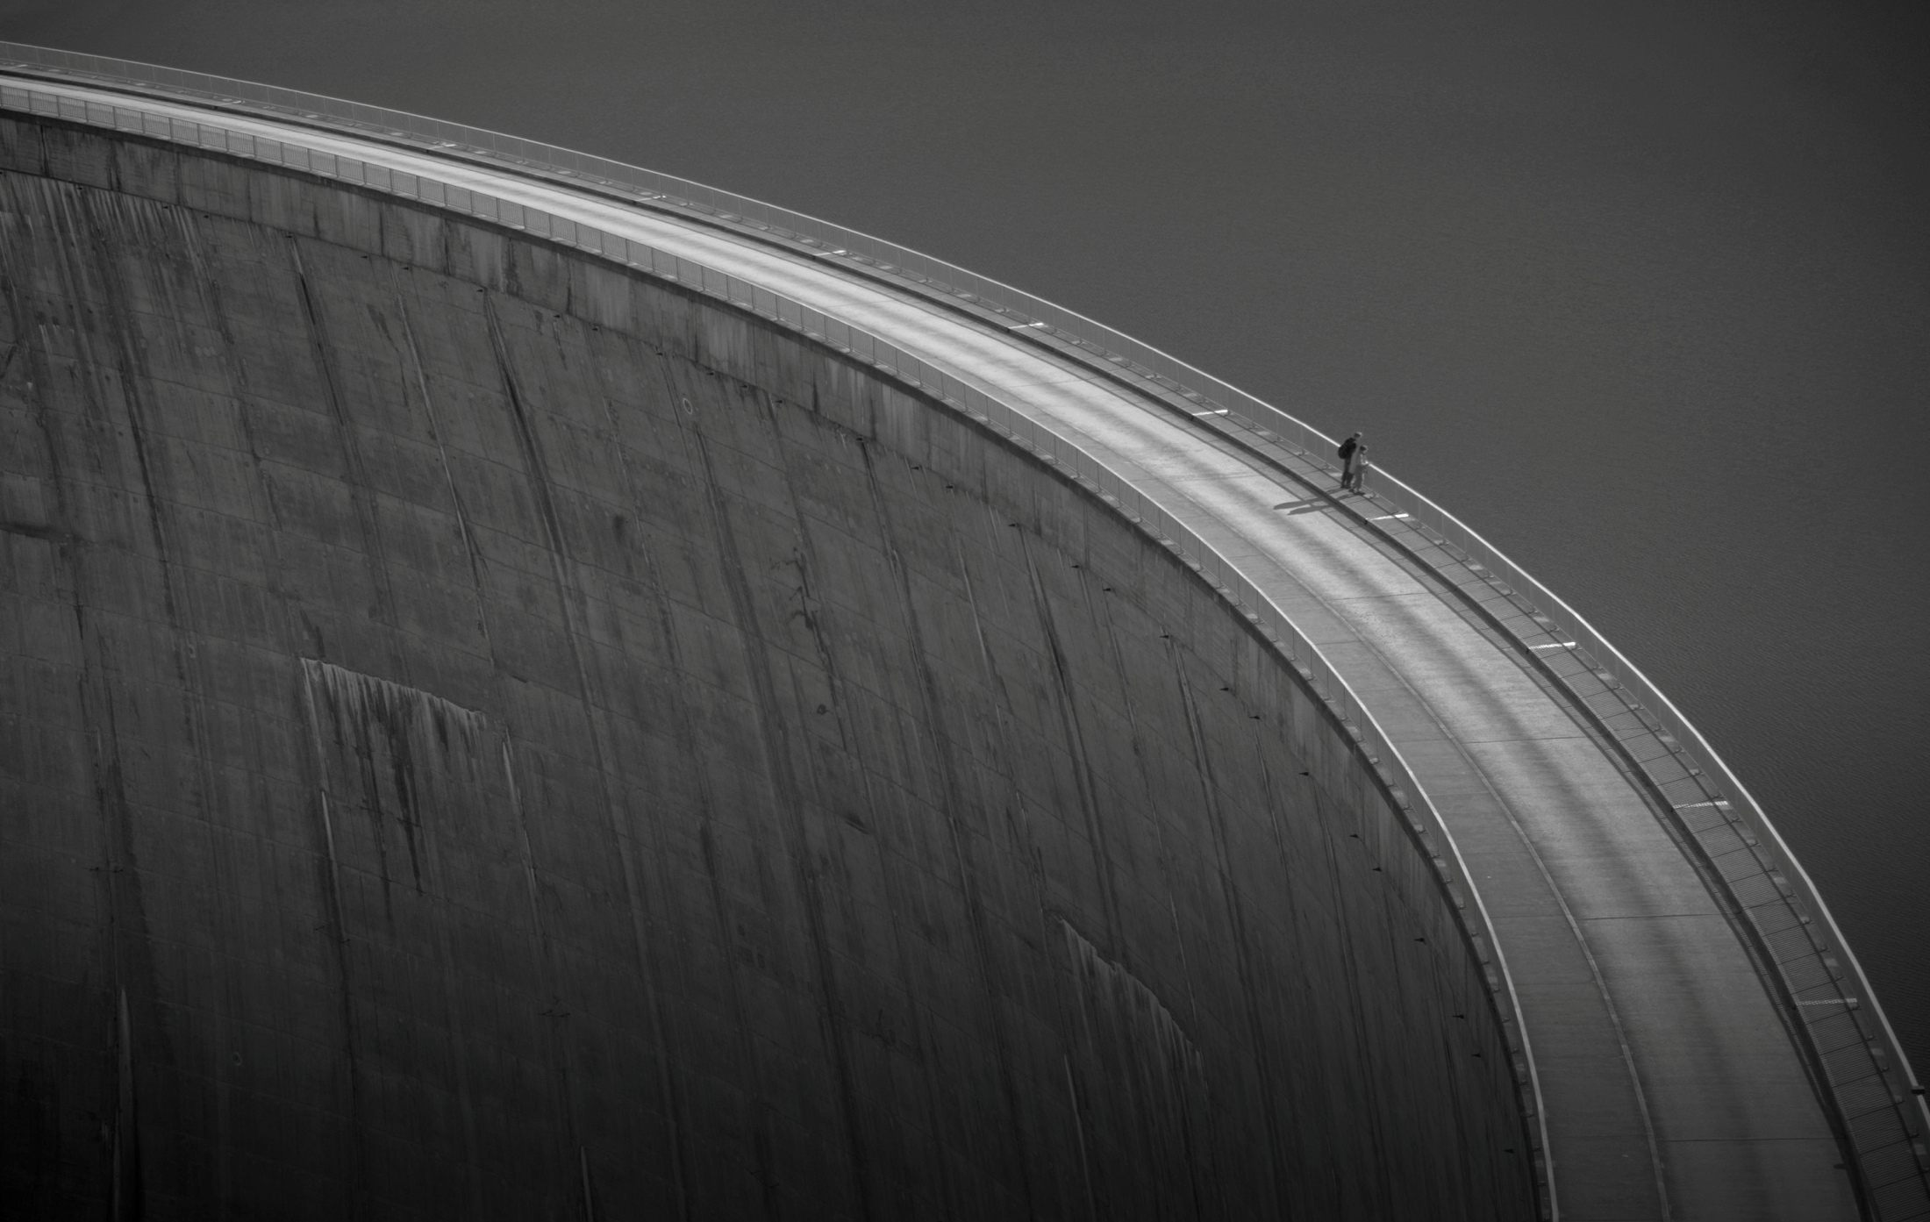
chennai . coimbatore . madurai . bengaluru . hyderabad . pune . ahmedabad. nagpur . delhi
www.swamyassociates.com

